Slide 1
Deep hedging with CVaR under Heston stochastic volatility
A twelve-week progression: simulator wins → reality-check failure
→ diagnosis → redesign → first statistically clean real-data win
Siddharth Chauhan · CH21B103
Dual Degree Project · Dept. of Data Science and AI · IIT Madras
Update · May 2026
Siddharth Chauhan · CH21B103 | DDP meeting
1 / 7

Slide 2
Initial objective and how it evolved
From a single-line Week-1 goal to a precisely-bounded empirical claim by Week 12
Where we started — Week 1
Where we ended up — Week 12
• Replicate Buehler et al. 2019: a neural-network policy that hedges an option by trading the underlying.
• Train under the Heston stochastic-volatility model, where Black–Scholes delta is provably sub-optimal.
• Minimise CVaR(95) of terminal P&L, not variance — target the tail a trader actually carries.
• Beat BS-delta on the simulator, and try to reach the analytical Heston Δ–ν ceiling.
• Simulator wins confirmed: deep hedger surpasses the analytical Δ–ν ceiling by +3.59 CVaR.
• Sim-to-real failure exposed (W7–8): same policy loses to BS on every real SPY crisis window.
• Block-bootstrap real-data retraining (W9) closes the in-period gap by 15×; COVID still loses.
• Diagnosis: timing not coverage. VIX + weekly rebal → first +ve OOT point estimate.
• Five-seed verification with pre-registered rules: 2024 OOT +1.16 ± 0.06 ✓; COVID rejected ✗.
Starting question
Final thesis statement
Can a neural hedger beat the textbook formula when the textbook's assumptions are wrong?
A CVaR-trained deep hedger beats the Heston ceiling in distribution, ties BS-delta on real SPY calibration periods, and beats BS-delta with high statistical significance on calm-market OOT windows.
Siddharth Chauhan · CH21B103 | DDP meeting
2 / 7

Slide 3
Methodology — core machinery (held constant across all 12 weeks)
Three layers — only the data feeding the loss changes between stages
Market model
Policy network
Loss function
• Heston SDE: dS = √v S dW, dv = κ(θ−v)dt + σ_v √v dZ, corr(dW,dZ) = ρ
• Bates extension: + Poisson jumps, λ_J = 1/yr, μ_J = −5%, σ_J = 8%
• MLE-calibrated to SPY 2005–2019: κ=2.31, θ=0.029, σ_v=0.53, ρ=−0.71
• Real-data mode (W9+): stationary block bootstrap (Politis–Romano), mean block = 10 days
• Variance-swap proxy: EWMA(λ=0.94) variance, scaled by σ_v^FIXED = 0.30
• Feed-forward MLP, 2–3 hidden × 64–96 units (~30k params)
• State: (S/S₀, VS/VS₀, t/T, prior positions) — 6 to 9 dims by stage
• Actions: tanh-clipped per instrument; stock ±2, VS ±5, VIX ±0.3 (W11)
• Final-layer init to zero so first epoch ≈ no-hedge baseline
• Optimiser: Adam, lr 1e-4 to 3e-4, batch 256–512, grad clip = 1.0
• L(π) = − CVaR_α(Π) + λ |E[Π]|
• CVaR via Rockafellar–Uryasev convex form:
• η + (1/(1−α)) · E[(L − η)⁺], jointly minimised in η
• α annealed 0.80 → 0.95 over training
• λ = 0 (W1–6) ; λ = 0.5 (W7+, mean-zero) ; λ = 1 (W8 sim-to-real)
Theory check (Week 7, Prop. 2): |CVaR_α(Π_Δt) − CVaR_α(Π_cont)| ≤ C√Δt — empirically R² = 0.93 in the rebalancing-frequency sweep.
Siddharth Chauhan · CH21B103 | DDP meeting
3 / 7

Slide 4
Methodology evolution
Each transition was forced by an empirical finding in the previous week
Framing
Heston + VS
SPX calibration
Analytical ceiling
Bates jumps
Multi-asset spread
Buehler 2019;
Heston + Bates;
CVaR vs quadratic
Bootstrap CIs;
DH+VS beats BS
by +2.43 CVaR
MLE on SPY
2005–2019;
κ=2.31, ρ=−0.71
Heston Δ–ν =
−14.68; DH+VS
−11.09 (+3.59)
BS −17.27 →
DH+VS −15.30
(Δ = +1.97)
4-instr DH
beats Margrabe
by +7.32 CVaR
Ablations + stress
Sim-to-real sweep
Block-bootstrap
Expanded corpus
VIX as vega
Multi-seed verify
Design defended;
FIRST real-SPY
test → BS wins
Bates+DR+λ-pen;
still loses to BS
on every window
Train on real
SPY 2005–17;
GFC gap 15× smaller
COVID in-train;
gap closes only
23% — falsified
Leverage fix;
first +ve OOT
point est. +0.66
Pre-registered;
2024 +1.16±0.06 ✓
COVID rejected ✗
Setup / framing
Clean win
Tie / partial
Failure / rejected
Diagnosis / verification
Siddharth Chauhan · CH21B103 | DDP meeting
4 / 7

Slide 5
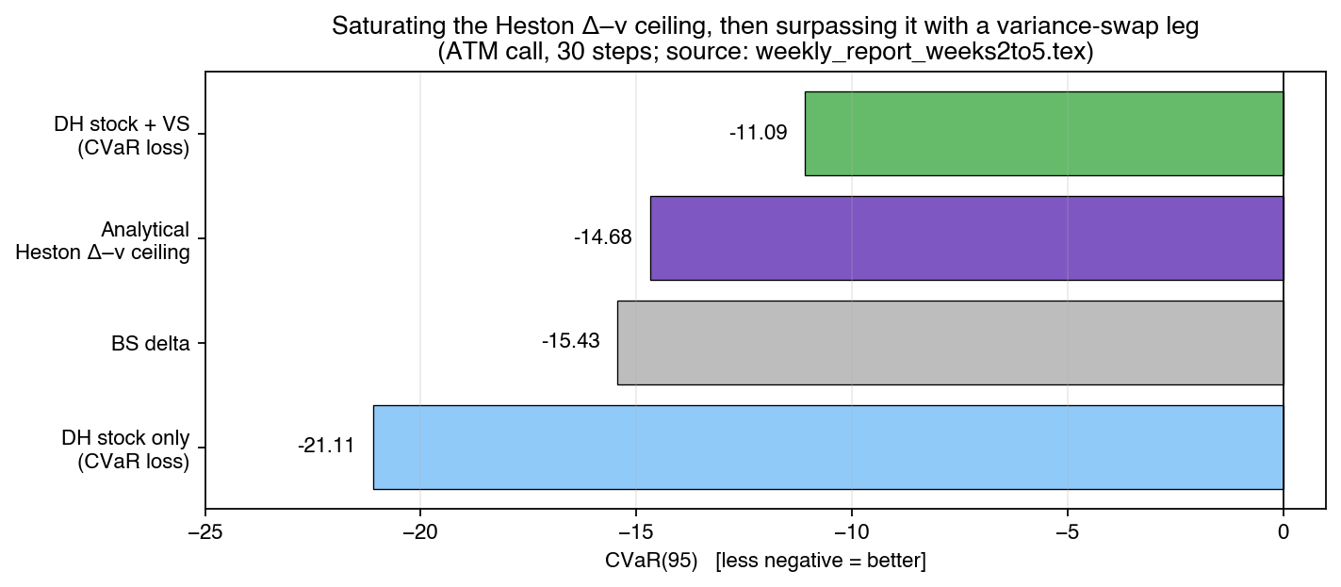
Results part 1 — Weeks 2–8: simulator wins, real data breaks
Weeks 7–8 — first test on real SPY
Window | BS CVaR | DH CVaR | Δ
2008 GFC | −12.12 | −21.38 | −9.26
2020 COVID | −8.59 | −9.43 | −0.84
2017 Calm | −2.62 | −6.94 | −4.32
Week 8 — every variant of the sim-to-real fix fails
• Bates + SPX-calibrated + DR + mean-penalty λ ∈ {0.5, 1, 2}.
• Best variant: 2008 Δ = −14 to −25 ; COVID Δ = −11 to −19.
• DH P&L std is 5× BS on real SPY — invariant to training regime.
Stock-only DH loses to BS. Adding a variance swap beats BS, and surpasses the analytical Heston Δ–ν ceiling by +3.59 CVaR.
Simulator wins (Weeks 2 – 6)
Setting | Baseline | DH improvement Δ
Heston ATM call (W2) | BS −15.92 | +2.43
Bates with jumps (W5) | BS −17.27 | +1.97
Heston ceiling (W3–4) | Δ–ν −14.68 | +3.59
Multi-asset spread (W6) | Margrabe −14.73 | +7.32
Honest conclusion: in-distribution claims hold, universal-market claim is retracted. Next: train on real returns.
Siddharth Chauhan · CH21B103 | DDP meeting
5 / 7

Slide 6
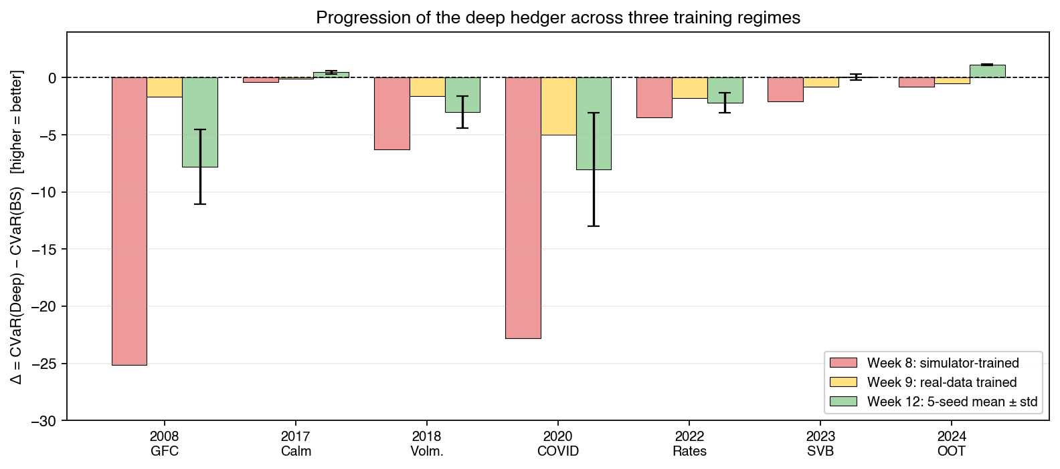
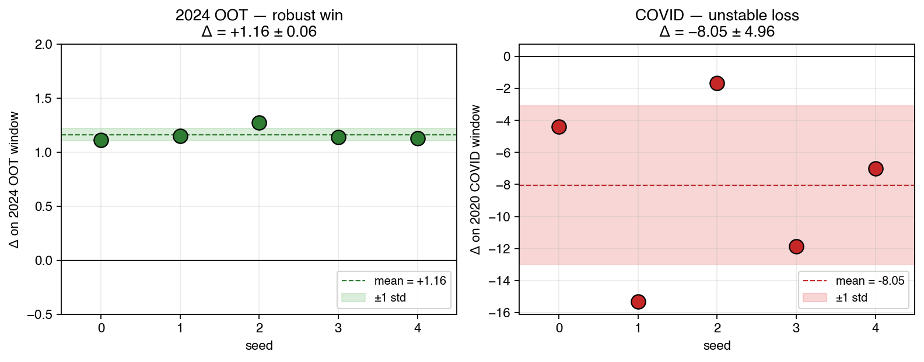
Results part 2 — Weeks 9–12: redesign, verify, characterise
What happened, week by week
• W9 block bootstrap on SPY 2005–17: GFC −25 → −1.67 (tie); COVID Δ = −6.47.
• W10 expanded to 2005–20 (COVID in-train): gap closes only 23% — coverage hypothesis falsified.
• Diagnosis: timing not coverage. EWMA lags; daily rebal too fast.
• W11 add VIX + weekly rebal: leverage fix needed (VIX moves 4× SPY); first +ve OOT estimate +0.66.
• W12 multi-seed × 5 + pre-registered rules.
Δ across 7 SPY windows in three training regimes — simulator-trained (W7-8, pink), real-data trained (W9-10, yellow), VIX-redesign 5-seed (W12, green ± seed-std).
Week 12: 5-seed verification
Window | mean Δ | std | Verdict
2008 GFC | −7.79 | 3.29 | unstable loss
2017 Calm | +0.48 | 0.14 | robust tiny win
2018 Volm. | −3.02 | 1.41 | unstable loss
2020 COVID | −8.05 | 4.96 | REJECTED
2022 Rates | −2.20 | 0.87 | small loss
2023 SVB | +0.07 | 0.27 | statistical tie
2024 OOT | +1.16 | 0.06 | ROBUST WIN ✓
Siddharth Chauhan · CH21B103 | DDP supervisor meeting
6 / 7
Per-seed Δ: 2024 OOT (tight, S/N ≈ 20:1) vs 2020 COVID (spread, std > |mean|).

Slide 7
Next steps — three candidate directions
Each option attacks a different hypothesis about the Week-12 crisis instability
OPTION A
OPTION B
OPTION C
Regime-gated architecture
(immediate next step)
Tail-robust optimisation
Neural SDE pivot
(Year-2 thesis spine)
Hypothesis
Hypothesis
Hypothesis
Action scale is wrong outside calm markets — the policy should shrink the VIX position when realised vol is high.
Crisis instability is an outlier-gradient problem at the optimiser, not at the policy class.
Real-data training is too noisy; a generative simulator matching SPX marginals + tails is enough to train on.
Method
Method
Method
Add a learned gate g(σ_realised) ∈ [0,1] in front of the VIX action; train end-to-end on the W12 corpus.
Replace mini-batch mean gradient with median-of-means (Minsker 2015; Lugosi–Mendelson 2019); architecture unchanged.
Fit a Neural SDE / Quant-GAN to SPY 2005–19; retrain hedger on its samples; test on real OOT 2020–24.
Profile
Profile
Profile
Lowest risk, fastest to test (≈1 week). Direct attack on the W12 diagnosis.
Cleanest theoretical story. Medium risk, medium scope.
Biggest scope, longest timeline, highest paper upside.
Current preference
A → B → C. Sprint A first because it directly tests the W12 diagnosis. Sprint B as fallback if A does not close the crisis gap. Neural SDE once the real-data story is stable.
Siddharth Chauhan · CH21B103 | DDP meeting
7 / 7

